Slide 1
William Stallings
Computer Organization and Architecture
6th Edition
CPU Structure

Slide 2
CPU Structure
CPU must:
  Fetch instructions from memory.
  Interpret instructions (determine function).
  Calculate operand addresses.
  Fetch data (from registers, memory, I/O).
  Process data (arithmetic, logic, etc.).
  Store results (in registers, memory, I/O).
Notes:
22

Slide 3
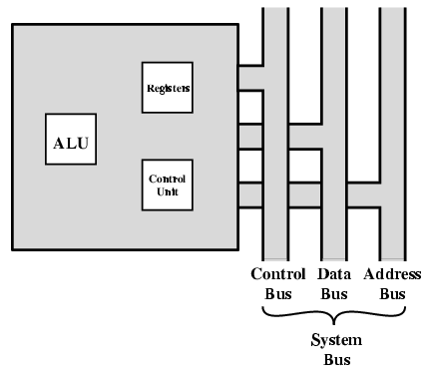
CPU With Systems Bus
CPU

Slide 4
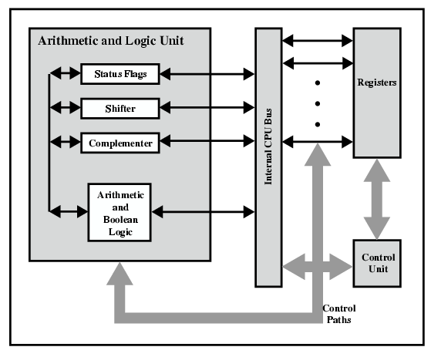
CPU Internal Structure
Register file

Slide 5
Registers
CPU working space (temporary storage).
Number and function vary between processor designs.
One of the major design decisions.
Top level of memory hierarchy – at CPU speed.
Notes:
23

Slide 6
User Visible (programmable) Registers
Alternatives:
General Purpose.
Data, possibly specialized uses.
Address.
Condition and other Status Codes.
Notes:
24

Slide 7
General Purpose Registers (1)
May be true general purpose - interchangeable in function.
Some may be restricted (e.g., no division).
May be used for data or addressing.
Data-only registers:
  Accumulator – no implied use in addressing.
Addressing-only registers:
  Segment register – no general-purpose arithmetic.
Notes:
25

Slide 8
General Purpose Registers (2)
Tradeoffs between general-purpose and specialized:
General purpose
  Increase flexibility and programmer options (compiler).
  Increase instruction size & complexity (must specify).
  Performance (speed).
Specialized
  Shorter (faster) instructions (implied by opcode).
  Less flexible (compiler optimization).
Notes:
26

Slide 9
How Many GP Registers?
Between 8 - 32. (More in a few designs.)
Fewer = more memory references required – lower performance.
More than 32 does not reduce memory references and takes up processor 'real estate'.
Notes:
27

Slide 10
How big?
Large enough to hold full address.
Large enough to hold full word.
Often possible to combine two data registers and use them as one bigger register (8, 16, 32); alternatively, address parts of a register.
Notes:
28

Slide 11
Condition Code and Status Registers
Sets of special-purpose bits.
  E.g., result of last operation was zero, sign, overflow.
Can be read (implicitly) by programs
  E.g. Branch if zero.
Mostly result of operation rather than set by program.
Behavior varies among CPUs.
Notes:
29

Slide 12
Program Status Word
A set of selected bits and registers defining state of execution.
Includes Condition Codes:
  Sign of last result.
  Zero.
  Carry.
  Equal.
  Overflow.
Interrupt enable/disable.
Supervisor/User mode of operation.
Etc.
Notes:
31

Slide 13
‘Invisible’ Registers
Program Counter (modified by jump/branch).
Instruction Register – holds opcode while decoding and executing.
Internal auxiliary data registers for operands and results.
Interface to memory:
  Memory Address Register.
  Memory Buffer (Data) Register.
Notes:
30

Slide 14

Example Register Organizations
Motorola – originally used by Apple, Intel – IBM PC
Motorola 6800 -> 68000, Intel 8080 -> 8086

Slide 15
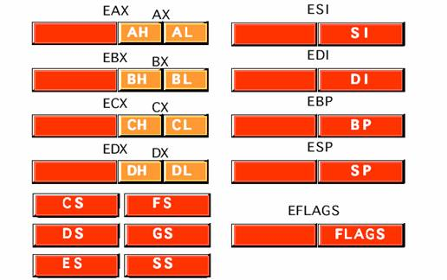
Registers:
CPU contains a unit called “Register file”.
This unit contains the registers of the
following types:
1. 8-bit general registers:
AL, BL, CL, DL, AH, BH, CH, DH
2. 16- bit general registers:
AX, BX, CX, DX, SP, BP, SI, Dl
3. 32-bit general registers:
EAX, EBX, ECX, EDX, ESP, EBP,
ESI, EDI (Accumulator, Base, Counter, Data, Stack pointer, Base pointer, Source index, Destination Index)
4. Segment registers: ES, CS ,SS, DS, FS, GS
5. instruction pointer: EIP
Note: the registers above are a partial list. There are more registers.

Slide 16
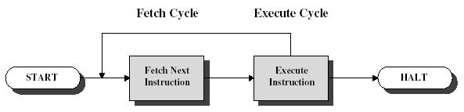
Basic Instruction Cycle

Slide 17
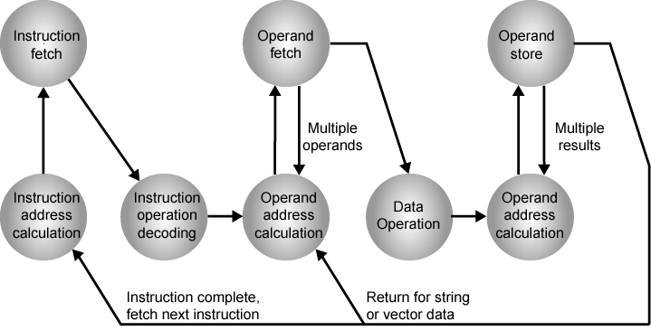
Instruction Cycle State Diagram

Slide 18

Instruction Fetch
PC = address of next instruction.
Address => MAR.
MAR => address bus.
Control unit requests memory read.
Result => data bus, MBR, IR.
PC incremented to point to next address. (unless told otherwise)
Operand addresses calculated.

Slide 19

Data Fetch From Memory
IR is decoded.
Operand addresses calculated.
Fetch operand from memory at MAR into MBR - as with instruction fetch.
If indirect addressing, indirect cycle is performed.
Load data into desired register.

Slide 20
Execute Cycle
Depends on instruction being executed.
Maybe
  Processor-memory
    data transfer between CPU and main memory
  Processor I/O
    Data transfer between CPU and I/O module
  Data processing
    Some arithmetic or logical operation on data
  Control
    Alteration of sequence of operations
    e.g. jump
  Combination of above

Slide 21
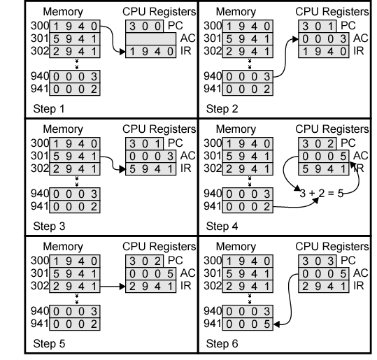
Example of Program Execution

Slide 22

Instruction Cycle with Interrupts

Slide 23

Instruction Cycle (with Interrupts) - State Diagram

Slide 24

Interrupt
Caused by hardware signal.
Current instruction completed.
Current PC saved to allow resumption after interrupt:
  PC => MBR
  Special memory address loaded to MAR.
  MBR written to memory.
  Possibly more data (status word) to memory.
PC <= address of interrupt handling routine.
Next instruction fetched from start of interrupt handler.

Slide 25
Interrupts
Mechanism by which other modules (e.g. I/O) may interrupt normal sequence of processing
Program
  e.g. overflow, division by zero
Timer
  Generated by internal processor timer
  Used in pre-emptive multi-tasking
I/O
  from I/O controller
Hardware failure
  e.g. memory parity error

Slide 26
Multiple Interrupts
Disable interrupts
  Processor will ignore further interrupts whilst processing one interrupt
  Interrupts remain pending and are checked after first interrupt has been processed
  Interrupts handled in sequence as they occur
Define priorities
  Low priority interrupts can be interrupted by higher priority interrupts
  When higher priority interrupt has been processed, processor returns to previous interrupt

Slide 27

Multiple Interrupts - Sequential

Slide 28
Multiple Interrupts – Nested

Slide 29
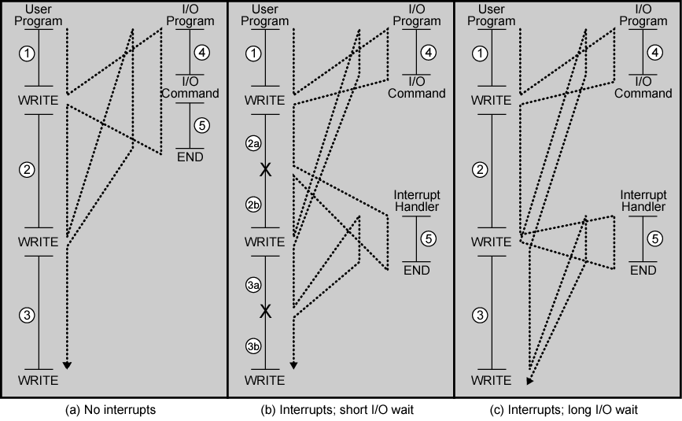
Program Flow Control

Slide 30

Time Sequence of Multiple Interrupts

Slide 31
Program Concept
Why?
  Hardwired systems are inflexible
  General purpose hardware can do different tasks, given correct control signals
  Instead of re-wiring, supply a new set of control signals

Slide 32
What is a program?
A sequence of steps
For each step, an arithmetic or logical operation is done
For each operation, a different set of control signals is needed

Slide 33
Improving Performance
Introduction:
  Instruction prefetch.
  Pipelining.
  RISC – CISC.
  Superscalar.
  Very Long Instruction Word (VLIW).
Pre-fetching.
Pipelining.
Notes:
22

Slide 34
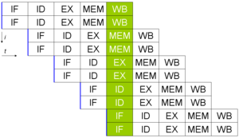
superscalar
A superscalar CPU architecture implements a form of parallelism called Instruction-level parallelism within a single processor. It thereby allows faster CPU throughput than would otherwise be possible at the same clock rate. A superscalar architecture executes more than one instruction during a single pipeline stage by pre-fetching multiple instructions and simultaneously dispatching them to redundant functional units on the processor.

Slide 35
Very long instruction word (VLIW)
Very long instruction word (VLIW) describes a computer processing architecture in which a language compiler or pre-processor breaks program instruction down into basic operations that can be performed by the processor in parallel (that is, at the same time). These operations are put into a very long instruction word which the processor can then take apart without further analysis, handing each operation to an appropriate functional unit.
VLIW is sometimes viewed as the next step beyond the reduced instruction set computing (RISC) architecture, which also works with a limited set of relatively basic instructions and can usually execute more than one instruction at a time (a characteristic referred to as superscalar). The main advantage of VLIW processors is that complexity is moved from the hardware to the software, which means that the hardware can be smaller, cheaper, and require less power to operate. The challenge is to design a compiler or pre-processor that is intelligent enough to decide how to build the very long instruction words. If dynamic pre-processing is done as the program is run, performance may be a concern.

